Slide 1
岩手大学 大学院工学研究科
October, 2016 プレゼンテーション試験
University Graduate School of Engineering
Master’s Program
萩原研究室
電気電子・情報システム工学専攻
ルンサワットヂサッブ ナンタナー
Notes:
Good afternoon. I would like to thank you everyone for coming today.
OK. Let me start my presentation.

Slide 2
Overview
Personal profile
Graduation research
Research of being a research student
Research plan
Notes:
I have divided my presentation in to 4 parts.
First, I will give you my brief profile.
Then, I will talk about my graduation research.
After that, I will present my research during this 5 months as a research student.
Finally, I will show you my research plan when I become a master course student.

Slide 3
Personal Profile
名前 : ルンサワットヂサッブ ナンタナー
出身地 ： タイ、バンコク
大学卒業 ： モンクット王工科大学ラートクラバン校
（King Mongkut’ｓ Institute of Technology Ladkrabang）
学部 ：理学部 ・コンピュータ・サイエンス学科
(Department of Computer Science)
Notes:
Let’s me introduce myself
I’m Rungsawasdisap Nantana from Thailand
I’m graduated Bachelor degree in Computer Science from King Mongkut’s Institute Technology Ladkrabang Thailand
Now I’m research student under Prof.Hagihara Yoshihiro

Slide 4
Graduation research
Arm Therapy Application (2011)
Notes:
Now, Let me give you some brief introduction to my graduation research.
When I was studying in university, I was engaged in “Arm Therapy Application with Wiimotes”
The research was supported from Rangsit hospital in Thailand.
Until the researches finished, I was given the advises by the physician from that hospital

Slide 5
Background of Graduation Research
Issues of current physical therapy applications and devices
High price
Difficult to carry
Lacking incentive to continue (for patients)
Objectives of these research
To reduce the costs
To reduce workload of physicians
To improve the motivation of patients
Notes:
I will taking about background of this research.
First, Issues of current physical therapy applications and devices are very high price, Difficult to carry and Lacking incentive to continue (for patients)
Second, Objectives of these research to reduce the costs, reduce workload of physicians and improve the motivation of patients.

Slide 6
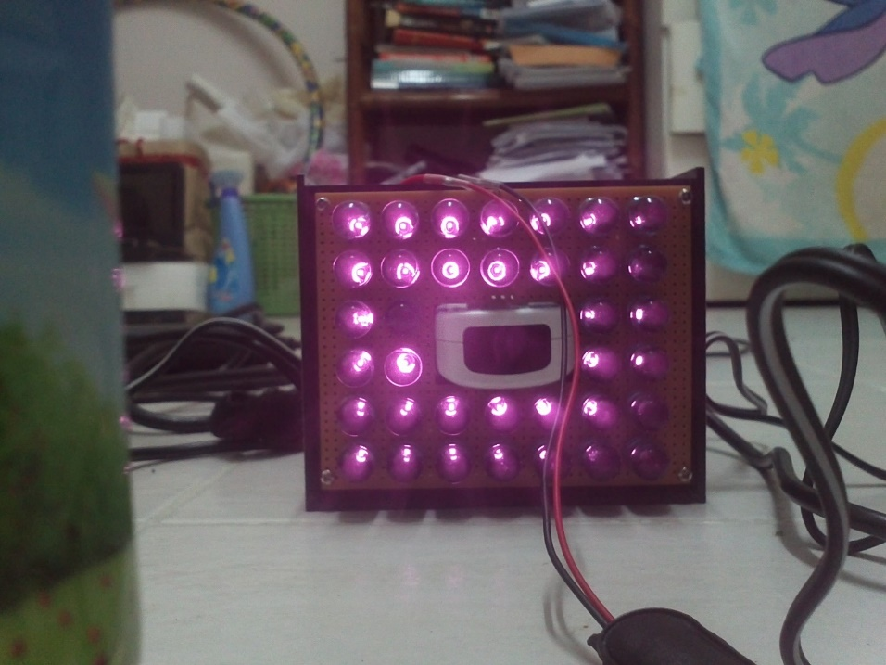
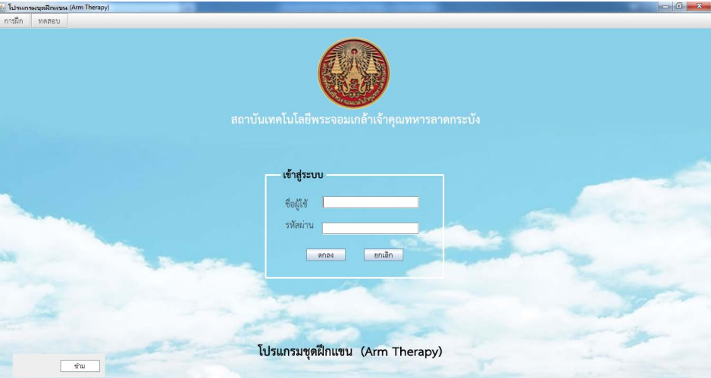
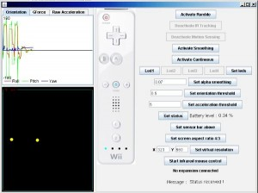

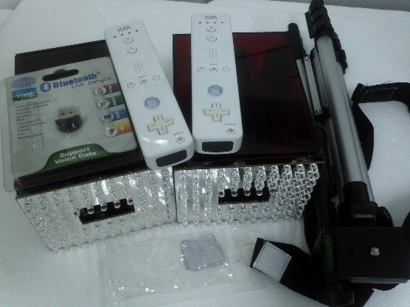
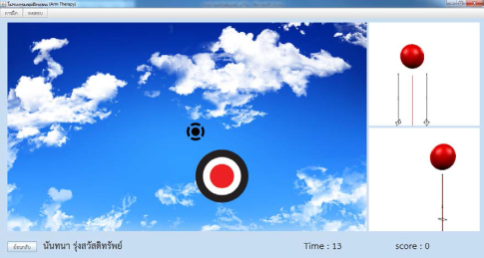


Arm Therapy Application with Wiimotes
Kit
Software
Notes:
In this picture, show you the kit that consist of circuit box that is infrared source, marker, and motion sensor (Wii Mote).
Then, the kit is working with this software that developed by java.

Slide 7
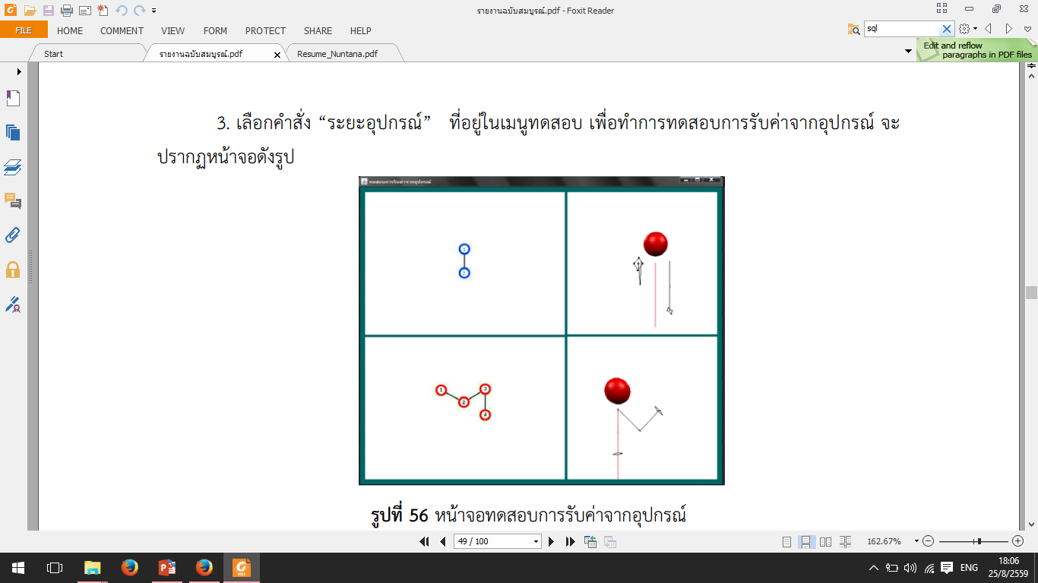
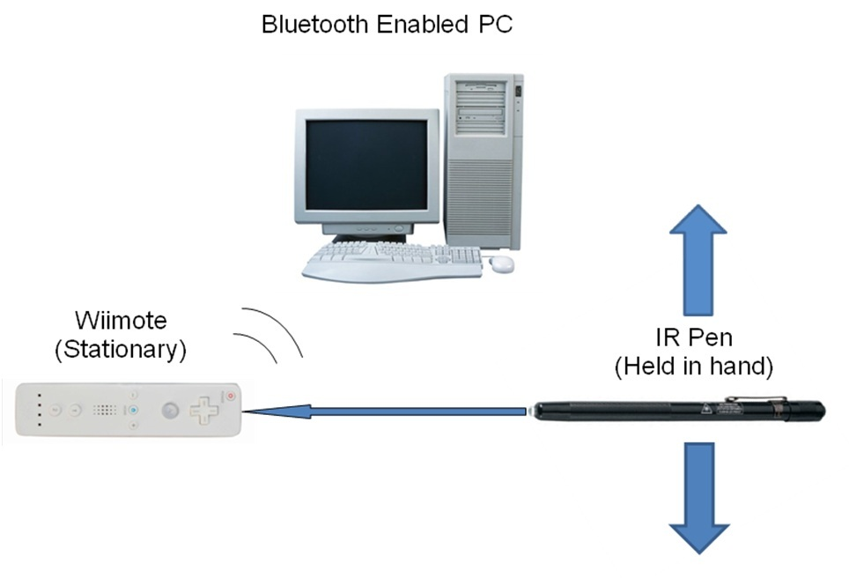
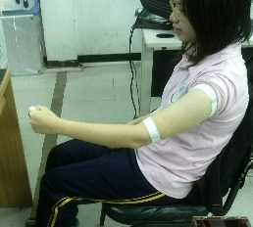
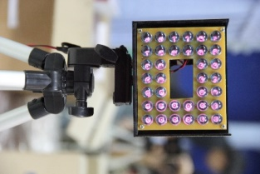
Arm Therapy Application
Send position of patient
to application
IR markers
attached on body
Notes:
Processes of the kit, starting from the circuit box radiate infrared to patient then marker reflects position of patient to wiimote which is sent to computer via Bluetooth signal for proceeding.

Slide 8
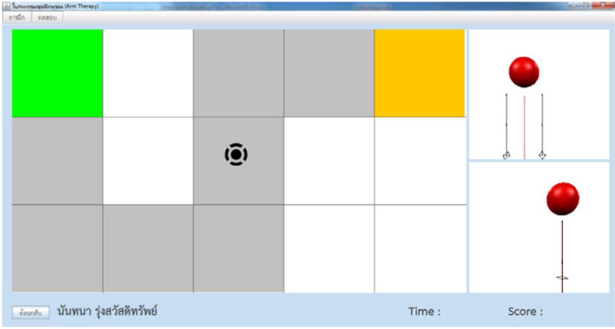
Arm Therapy Application with Wiimotes
This application use for support physical therapy and arm muscle training to improve arm muscle.
Application has 2 types of training
Moving arm follow to random point
Moving arm follow the patterns (created by physician)
Fig.1
Fig.2
Notes:
In this program use for support physical therapy and arm muscle traning to improve arm muscle
Application has 2 types of training
The first type is moving arm follow to random point
The second type is moving arm follow the patterns (created by physician)
In figure 1 is an interface of the first type of training
And figure 2 is an interface of the second type of training

Slide 9
研究生の時
Human Gesture Interface
with Perception Neuron
using Hidden Markov Model
Notes:
Now let’s move on to my research of being a student research
In the subject Human Gesture Interface with Perception Neuron using Hidden Markov Model

Slide 10
Background
Human Gesture Recognition
Motion Capture Sensor “Perception Neuron MOCAP”
Machine Learning “Hidden Markov Models”
Notes:
I would like to talk about the Background of my research.
In recently invention of human gesture recognition,Machine Learning and motion capture sensor has received interest in the fields of computer vision
And there are many challenges associated with the accuracy and usefulness of gesture recognition application using machine learning

Slide 11

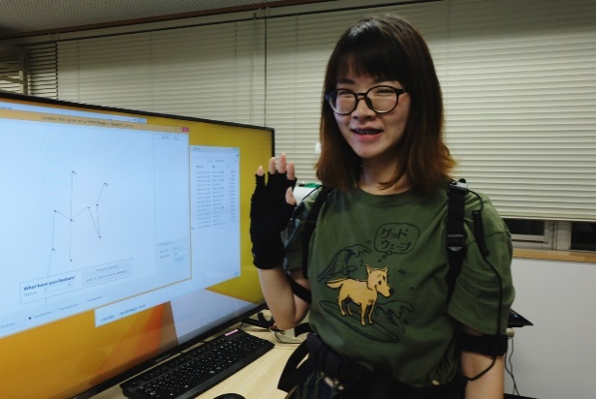
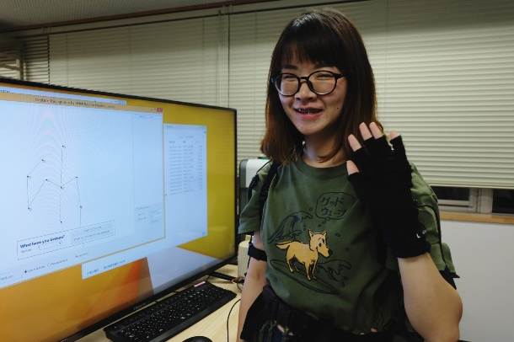

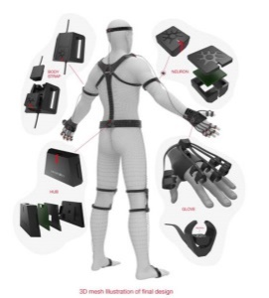
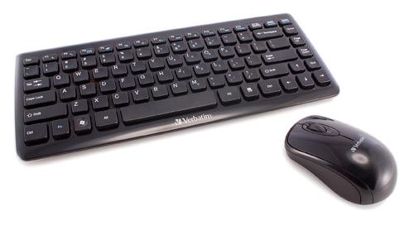

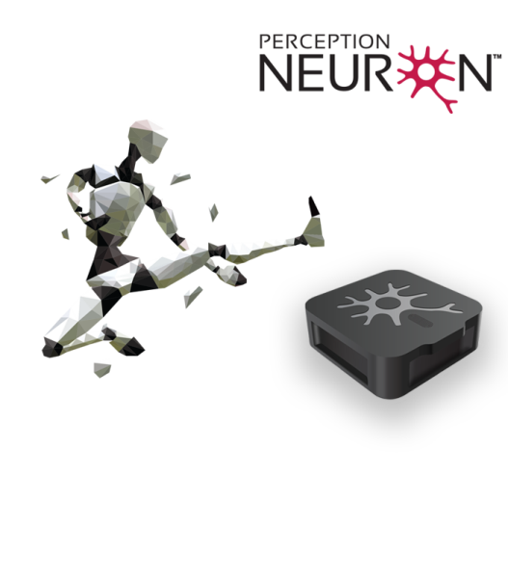


Introduction
HMMs
Input gesture commands
motion data from Neuron MOCAP
performs output
Human Gesture Recognition with Perception Neuron using HMM - a demo
Open
An application is simple gesture recognition which can open some windows software by itself (Paint,Notepad,Calculator)
Notes:
So I developed a simple gesture recognition system with Neuron MOCAP using HMMs
Allowing users to input gesture commands instead of mouse and keyboard
With collecting motion data from Neuron MOCAP over 300 samples and then using this data to train a motion gesture recognition model based on hidden markov model.
The goal is to develop simple gesture recognition application which can open some windows software by itself (Paint,Notepad,Calculator)

Slide 12
Objectives
To investigate/study the effectiveness of the Neuron MOCAP and Hidden Markov Models for gesture recognition
To develop a general gesture recognition system that can be easily used by anyone with a simple application
To construct simple gesture models which can be easily recognized for opening different windows applications
Notes:
The objectives of this research has devied into 3 points.
First,To investigate/study the effectiveness of the Neuron MOCAP and Hidden Markov Models for gesture recognition
After that,To develop a general gesture recognition system that can be easily used by anyone with a simple application
Finally,To construct simple gesture models which can be easily recognized for opening different windows applications

Slide 13
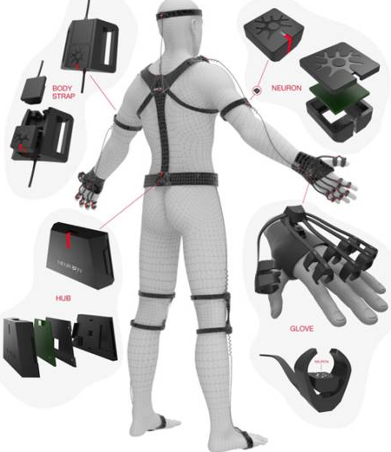
Motion Capture Data from Neuron Data Reader Framework
NeuronDataReader receives data(*) from Neuron. The calculation data in each frame include all the sensor data and motion data of 21 bones, for example position data
Neuron
DataReader
Calculation Data & Bone Data Array
Output
Neuron’s Socket
(*) calculation data
Notes:
For motion data from Neuron data reader framework that is Calculation data
In each frame include all the sensor data and raw motion data of 21 bones, for example 3-axis of position data
The figure show simple structure of process of NeuronDataReader

Slide 14
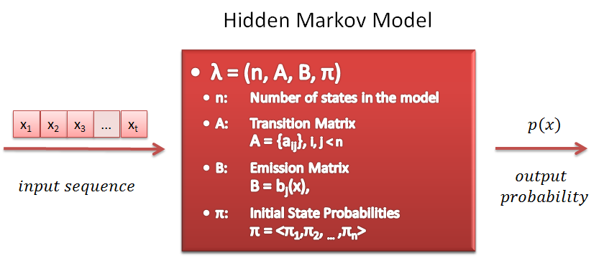

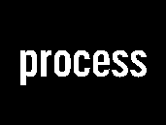
Hidden Markov Model from The Accord.NET Framework
Accord.NET is Image Processing and Machine Learning Framework in C#
Can construct hidden markov model by data sequence
Support for the performance measurements techniques
Hidden Markov Model
(Accord.NET Framework)
Motion gesture data
Notes:
The next I would like to talk about Framework I used
Accord.NET is Image Processing and Machine Learning Framework in C#
It can construct hidden markov model by data sequence
Convenient to work with an approximate model
And support for the performance measurements techniques
The Hidden Markov Model is suitable algorithm for the recognition of dynamic gestures in real time.If you search about recognition system you will see another relate work the use this model.

Slide 15
Work Flow
Start application and connect Neuron
Receive calculation data from NeuronDataReader library and paint skeleton
Open gesture model from xml file
yes
Is model ready?
no
Create new gesture model
(at least 3 samples for each class and at least 3 classes)
Run the Hidden Markov Models learning
Classify all training instances
Recognize of gesture
program will open
Notes:
Next,is work flow of demo process.
In the first, when start program and connected Neuron MOCAP
When receive calculation data from NeuronDataReader library and next application will paint each of neuron skeleton from calculation data
Next step If user had gesture model ready, user can open gesture model with browsing the xml file
But , If user don’t has model , should be create new gesture model (That model should be at least 3 samples for each class and at least 3 classes)
And the next step to recognize of gesture you must run the HMMs learning from your model
The last step application will call a windows program and then that program will open

Slide 16
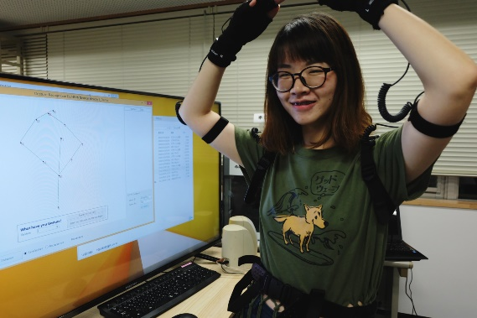

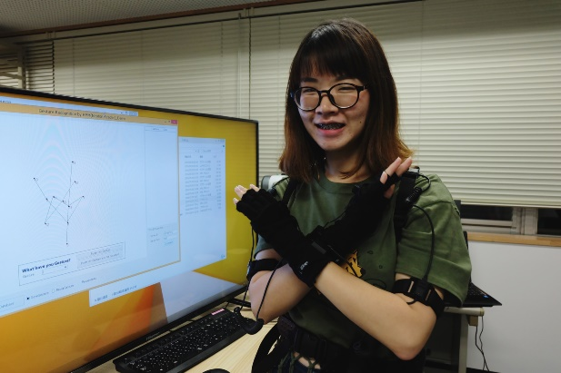
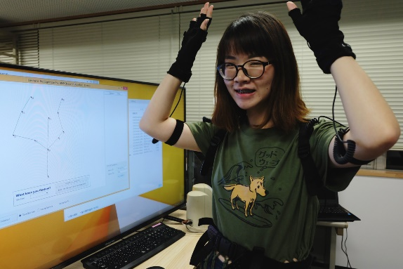
Means of gestures
Waving right hand gesture
- It means open the Notepad program
Raising hands in a circle
- It means “Yes” or “Confirm”
Waving left hand gesture
- It means open the Paint program
Waving left & right hands gesture
- It means open the Calculator program
Crossing arms to form an ‘X’
- It means “No” or “Cancel”
Notes:
This slide to show means of gestures
First gesture is Waving right hand gesture : It means open the Notepad program
Second gesture is Waving left hand gesture : It means open the Paint program
Third gesture is Waving left & right hands gesture : It means open the Calculator program
Next gesture is Raising hands in a circle : It means “Yes” or “Confirm”
Last gesture is Crossing arms to form an ‘X’ : It means “No” or “Cancel”

Slide 17
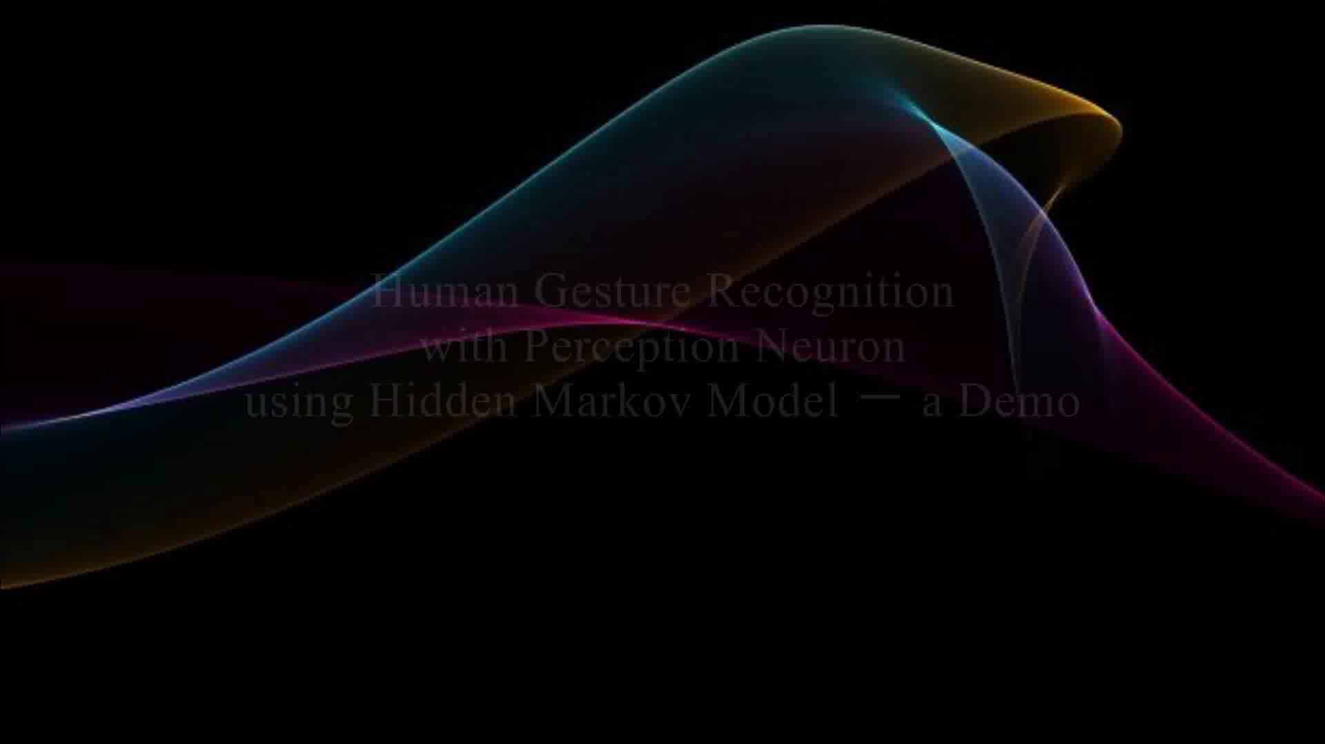
Video of demo
Notes:
Let me show you about my video demo

Slide 18
Conclusions
The Human Gesture Interface with Perception Neuron using HMM can be considered as a useful system to enable user to easily control
The data generated by Neuron MOCAP was unstable because of the magnetic interference issues
HMM from The Accord.NET Framework can be said a good choice for gesture recognition
Notes:
Now , let me conclude this research.
The Human Gesture Interface with Perception Neuron using HMMs could be considered as a helpful device to enable user to easily control
The data generated by Neuron MOCAP was unstable because of the magnetic interference issues
HMMs from The Accord.NET Framework could be said a good choice for gesture recognition
the accuracy rate is also increased with increased training of the system.

Slide 19
入学後の研究計画
Human Motion Recognition with Perception Neuron using Deep Learning
Notes:
Finally , I will talk about my future research.
Human Motion Recognition with Perception Neuron using Deep Learning

Slide 20
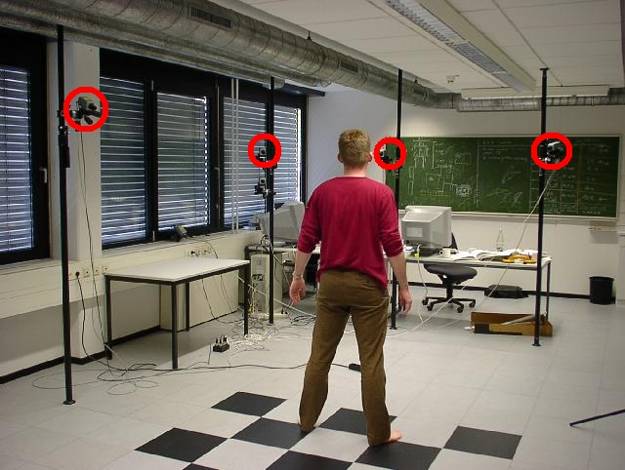
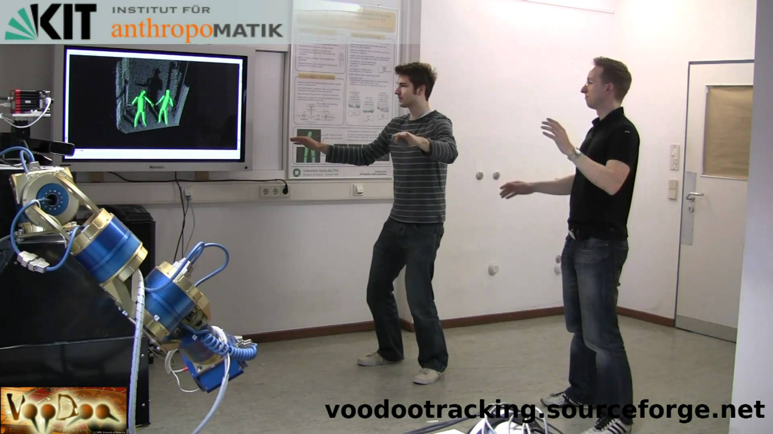
Human Motion Recognition
Not only essential for understanding and analyzing human activity but also important for serving many application areas ranging from visual surveillance to human computer interaction systems
Until now, a lot of approaches have been proposed using different devices and different classifiers. Many studies are still being actively pursued in this area.
Fig1.Full Body Motion Tracking with Voodoo and Microsoft Kinect
Fig 2.Human Motion Capture Using a Combination of 2D Feature Tracking and 3D Visual Hull Reconstruction
Notes:
Human motion recognition is a very active topic.
And , currently, there are a lot of research about it.
Because , it’s not only essential for understanding and analyzing human activity but also important for serving many application areas ranging from visual surveillance to human computer
So , until now, a lot of approaches have been proposed using different devices and different classifiers. Many studies are still being actively pursued in this area.

Slide 21
Related Works
Feature data obtained by using different sensors
Microsoft Kinect
Vicon motion capture
FRID tags
Stereo camera
Other devices
Classification achieved by employed different algorithms
Hidden Markov Model
Super Vector Machine
Random Forests
Convolutions Neuron Networks
Other algorithms
Notes:
Depending on the characteristics of features many approaches have been proposed.
In those approaches , Feature data was obtained by using different sensors such as
Microsoft Kinect , Vicon motion capture ,FRID tags , Stereo camera and Other devices
And classification was achieved by employed different algorithms such as
Hidden Markov Model ,Super Vector Machine , Random Forests ,Convolutions Neuron Networks and Other algorithms

Slide 22
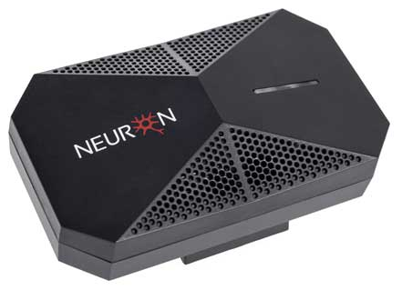
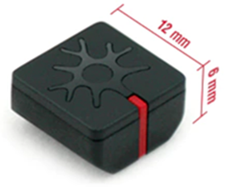
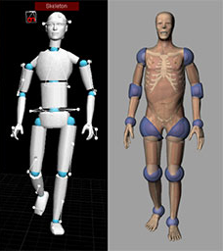
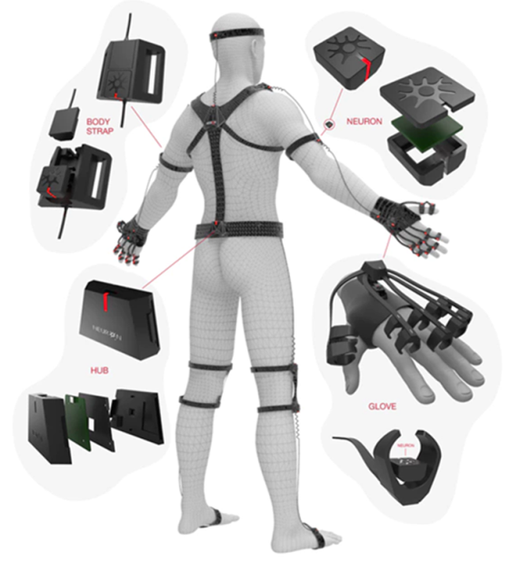
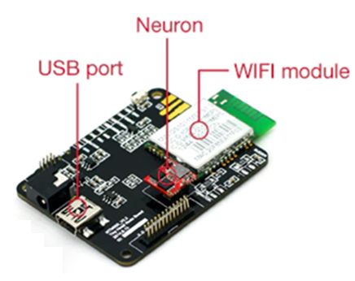
Why Neuron MOCAP ?
SMALL : Iightweight and more portable
ROBUST: Insusceptible to occlusions
ADAPTIVE : via USB , WIFI and Micro-SD
VERSATILE : Provided with an SDK with a C/C++ API Integrations into Unity3D
Notes:
Why I choose Neuron MOCAP, because Neuron MOCAP has many advantages.
SMALL : It’s lightweight and more portable
ROBUST : It’s unsusceptible to occlusions
ADAPTIVE : The system can handle from 1 to 32 Neurons, can be connected with three different ways: (1) via WIFI, (2) via USB or (3) and can recorded data with micro-SD
VERSATILE : Can easily to export raw data of sensors, every type of user is catered. Can be provided with an SDK with a C/C++ /C# API and integrations into Unity3D.
That is result why I choose Neuron.

Slide 23
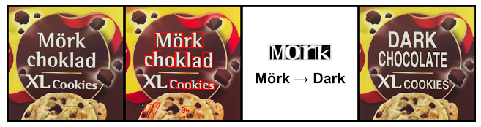
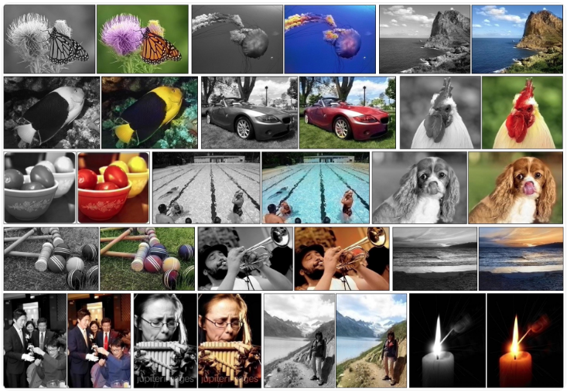
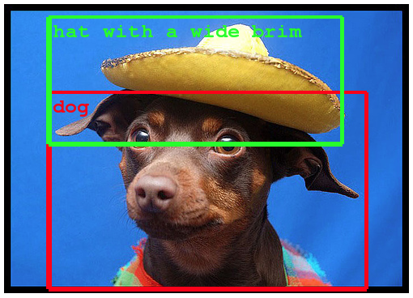
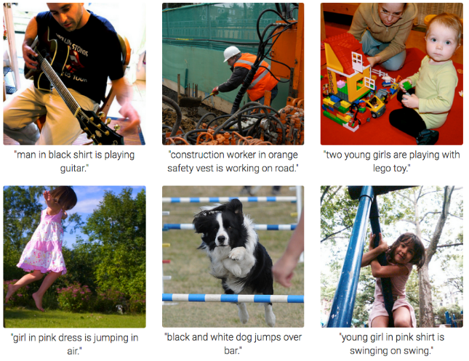
Why Deep Learning ?
Recently, deep neural networks that are trained using an end-to-end learning procedure have gained much attention for their ability to solve various machine-learning problems, including object recognition semantic segmentation, caption generation, robotic manipulation, etc.
Fig2. Automatic Machine Translation
Fig 1. Automatic Colorization of Black and White Images
Fig 3. Object Detection in Photographs
Deep Learning Trends
Fig 4. Automatic Image Caption Generation
http://machinelearningmastery.com/inspirational-applications-deep-learning/
Notes:
Why I want to study about Deep Learning.
Recently, deep neural networks that are trained using an end-to-end learning procedure have gained much attention for their ability to solve various machine-learning problems, including object recognition semantic segmentation, caption generation, robotic manipulation, and other subjects

Slide 24
Work Plan
Investigate relative researches to deepen my understanding of this filed
Find a suitable deep learning algorithm to be used in my human motion recognition system
On the base of the current framework to develop a recognition system which can recognize complex human motion.
Notes:
Now, I want to end my presentation after explained my brief work plan. I will furtherly investigate the relative researches about gesture/posture recognition to deepen my understanding of this filed.
Also, I will try to find a suitable deep learning algorithm to use it in my research.
Then, on the base of the current framework I will be engaged in developing a recognition system which can recognize complex human motion.

Slide 25
Thank you FOR YOUR ATTENTION

